Slide 1
AWK
Notes:
The Bash Shell
Copyright Department of Computer Science, Northern Illinois University, 2005
09-<number>

Slide 2
WHAT IS AWK?
created by: Alfred V Aho, Weinberger, and Kernighan
used for processing text files, particularly data files that are organized by rows and columns
Notes:
The AWK/NAWK Utility
Copyright Department of Computer Science, Northern Illinois University, 2004

Slide 3
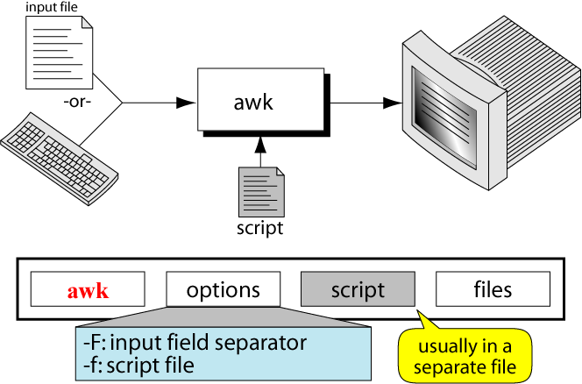
THE COMMAND: AWK

Slide 4
BASIC AWK SYNTAX
awk ‘pattern{action}’ inputfile
awk –f scriptfile.awk inputfile
Options:
-F to change input field separator
-f to name script file
Notes:
The AWK/NAWK Utility
Copyright Department of Computer Science, Northern Illinois University, 2004

Slide 5
AWK OPERATION:
  scans a file line by line
  splits each input line into fields
  compares input line/fields to pattern
  performs action(s) on matched lines

Slide 6
BASIC TERMINOLOGY: INPUT FILE
A field is a unit of data in a line
Each field is separated from the other fields by the field separator
  default field separator is whitespace
A record is the collection of fields in a line
A data file is made up of records
Notes:
The AWK/NAWK Utility
Copyright Department of Computer Science, Northern Illinois University, 2004

Slide 7
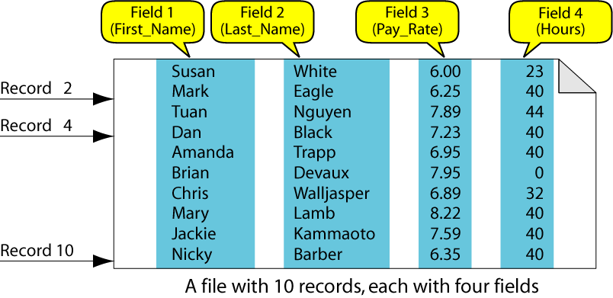
EXAMPLE INPUT FILE

Slide 8
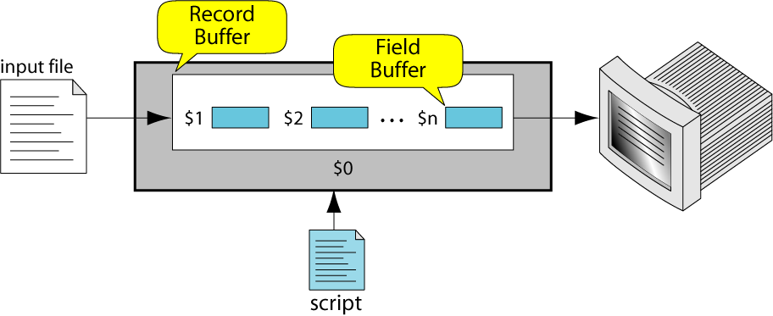
BUFFERS
awk supports two types of buffers:
record and field
field buffer:
  one for each fields in the current record.
  names: $1, $2, …
record buffer :
  $0 holds the entire record

Slide 9
SYSTEM VARIABLES
FS Field separator (default=whitespace)
RS Record separator (default=\n)
NF Number of fields in current record
NR Number of the current record
OFS Output field separator (default=space)
ORS Output record separator (default=\n)
FILENAME Current filename

Slide 10
EXAMPLE: RECORDS AND FIELDS
% cat emps
Tom Jones 4424 5/12/66 543354
Mary Adams 5346 11/4/63 28765
Sally Chang 1654 7/22/54 650000
Billy Black 1683 9/23/44 336500
% awk '{print NR, $0}' emps
1 Tom Jones 4424 5/12/66 543354
2 Mary Adams 5346 11/4/63 28765
3 Sally Chang 1654 7/22/54 650000
4 Billy Black 1683 9/23/44 336500
Notes:
The AWK/NAWK Utility
Copyright Department of Computer Science, Northern Illinois University, 2004

Slide 11
EXAMPLE: SPACE AS FIELD SEPARATOR
% cat emps
Tom Jones 4424 5/12/66 543354
Mary Adams 5346 11/4/63 28765
Sally Chang 1654 7/22/54 650000
Billy Black 1683 9/23/44 336500
% awk '{print NR, $1, $2, $5}' emps
1 Tom Jones 543354
2 Mary Adams 28765
3 Sally Chang 650000
4 Billy Black 336500
Notes:
The AWK/NAWK Utility
Copyright Department of Computer Science, Northern Illinois University, 2004

Slide 12
EXAMPLE: COLON AS FIELD SEPARATOR
% cat em2
Tom Jones:4424:5/12/66:543354
Mary Adams:5346:11/4/63:28765
Sally Chang:1654:7/22/54:650000
Billy Black:1683:9/23/44:336500
% awk -F: '/Jones/{print $1, $2}' em2
Tom Jones 4424
Notes:
The AWK/NAWK Utility
Copyright Department of Computer Science, Northern Illinois University, 2004

Slide 13
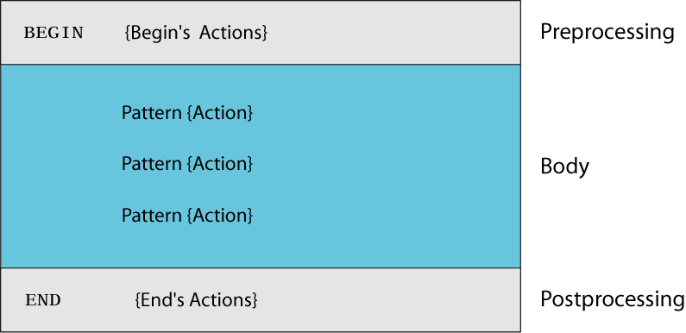
AWK SCRIPTS
awk scripts are divided into three major parts:
comment lines start with #

Slide 14
AWK SCRIPTS
BEGIN: pre-processing
  performs processing that must be completed before the file processing starts (i.e., before awk starts reading records from the input file)
  useful for initialization tasks such as to initialize variables and to create report headings

Slide 15
AWK SCRIPTS
BODY: Processing
  contains main processing logic to be applied to input records
  like a loop that processes input data one record at a time

Slide 16
AWK SCRIPTS
END: post-processing
  executed after all input data have been read
  information accumulated during processing can be analyzed and printed

Slide 17
AWK OPERATION
  scans a file line by line
  splits each input line into fields
  compares input line/fields to pattern
  performs action(s) on matched lines

Slide 18
AWK OPERATION EXAMPLE
BEGIN { print “totals” }
{
total = $1 + $2 + $3
print $1 “ +” $2 “+” $3 “=“ total
}
END { print “total completed”}

Slide 19
PATTERN
Patter n identifies which records in a file are to receive an action
As it execute a script, it evaluate the patterns against the records found in the file
If the pattern matches the record the action is taken
If the pattern doesn’t match the record then the action is skipped
A statement without pattern is always true, and the action is always taken

Slide 20
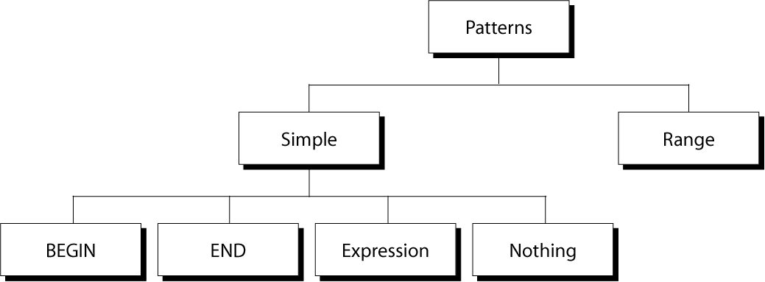
CATEGORIES OF PATTERNS

Slide 21
BEGIN AND END
BEGIN is true at the beginning of the file before the first record is read
BEGIN used to initialize the script before processing any data
END is used at the conclusion of the script
  Print user defined variables accumulated during the processing
BEGIN
{
FS = “\t”
OFS = “\t”
}
.
.
END
{
print(“total slaes”, total)
}

Slide 22
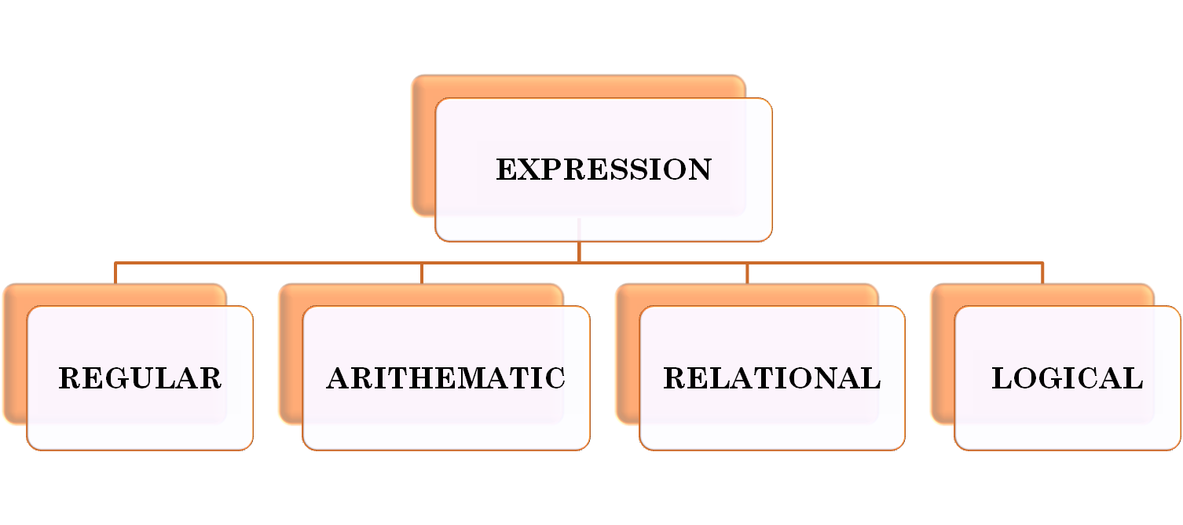
EXPRESSION PATTERN TYPES

Slide 23
REGULAR EXPRESSIONS
  Same as egrep
  In addition to the reg exp awk requires one of two operators
    ~ match
    ! ~ not match
  When using reg exp it must be enclosed in / slashes /
    $0 ~ /^A.*B$/
    $3 !~ /^ /
    $4 !~ /bird/
Notes:
The AWK/NAWK Utility
Copyright Department of Computer Science, Northern Illinois University, 2004

Slide 24
EXAMPLE: MATCH INPUT RECORD
% cat employees2
Tom Jones:4424:5/12/66:543354
Mary Adams:5346:11/4/63:28765
Sally Chang:1654:7/22/54:650000
Billy Black:1683:9/23/44:336500
% awk –F: '/00$/' employees2
Sally Chang:1654:7/22/54:650000
Billy Black:1683:9/23/44:336500
Notes:
The AWK/NAWK Utility
Copyright Department of Computer Science, Northern Illinois University, 2004

Slide 25
EXAMPLE: EXPLICIT MATCH
% cat datafile
northwest NW Charles Main 3.0 .98 3 34
western WE Sharon Gray 5.3 .97 5 23
southwest SW Lewis Dalsass 2.7 .8 2 18
southern SO Suan Chin 5.1 .95 4 15
southeast SE Patricia Hemenway 4.0 .7 4 17
eastern EA TB Savage 4.4 .84 5 20
northeast NE AM Main 5.1 .94 3 13
north NO Margot Weber 4.5 .89 5 9
central CT Ann Stephens 5.7 .94 5 13
Notes:
The AWK/NAWK Utility
Copyright Department of Computer Science, Northern Illinois University, 2004

Slide 26
EXAMPLES: MATCHING WITH RES
% awk '$2 !~ /E/{print $1, $2}' datafile
northwest NW
southwest SW
southern SO
north NO
central CT
Notes:
The AWK/NAWK Utility
Copyright Department of Computer Science, Northern Illinois University, 2004

Slide 28
ARITHMETIC OPERATORS
Operator Meaning Example
+ Add x + y
- Subtract x – y
* Multiply x * y
/ Divide x / y
% Modulus x % y
^ Exponential x ^ y
Example:
% awk '$3 * $4 > 300 {print $0}' file
Notes:
The AWK/NAWK Utility
Copyright Department of Computer Science, Northern Illinois University, 2004

Slide 29
RELATIONAL OPERATORS
Operator Meaning Example
< Less than x < y
< = Less than or equal x < = y
== Equal to x == y
!= Not equal to x != y
> Greater than x > y
> = Greater than or equal to x > = y
~ Matched by reg exp x ~ /y/
!~ Not matched by req exp x !~ /y/
awk ‘$1 == “susan” {print}’ file
Notes:
The AWK/NAWK Utility
Copyright Department of Computer Science, Northern Illinois University, 2004

Slide 30
LOGICAL OPERATORS
Operator Meaning Example
&& Logical AND a && b
|| Logical OR a || b
! NOT ! a
Examples:
% awk '($3>5) && ($4>30){print $0}' file
Notes:
The AWK/NAWK Utility
Copyright Department of Computer Science, Northern Illinois University, 2004

Slide 31
NOTHING(NO PATTERN)
When no address pattern is entered , awk applies the action to every line in the input file
This is the easiest way to specify that all lines are to be processed

Slide 32
RANGE PATTERNS
Matches ranges of consecutive input lines
Syntax:
pattern1 , pattern2 {action}
pattern can be any simple pattern
pattern1 turns action on
pattern2 turns action off

Slide 33
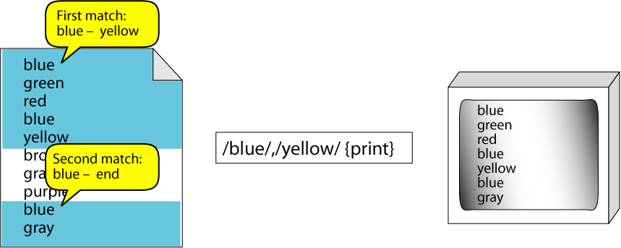
RANGE PATTERN EXAMPLE

Slide 34
ACTIONS
Actions are known as instructions or statements
They are called actions becoz they act when the pattern is true
In AWK the action is one or more statements associated with a pattern
There is one to one relationship between an action and a pattern
The action statement must be enclosed in a set of braces; even if there is only one statement
Set of braces containing pattern/action pair or statements is known as a block
When the action consist of several statements , they must be separated by a statement separator

Slide 35
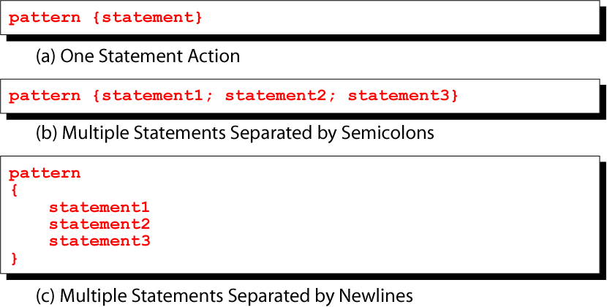
PATTERN / ACTION SYNTAX

Slide 36
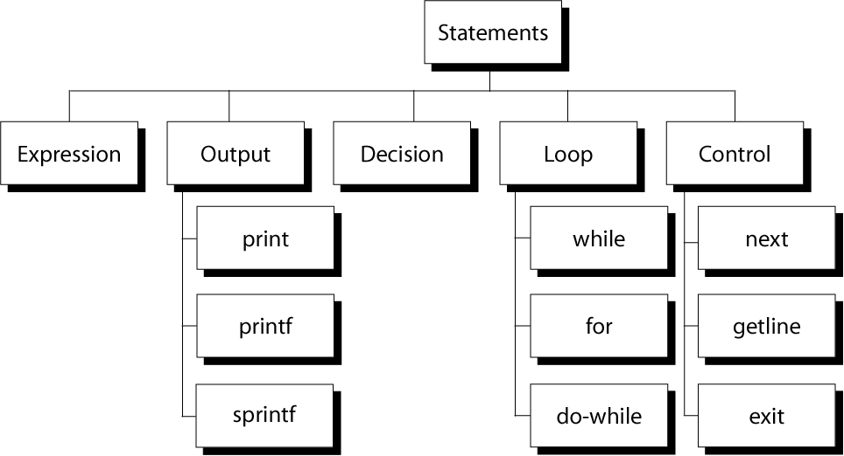
AWK ACTIONS

Slide 37
AWK EXPRESSIONS
Expression is evaluated and returns value
  consists of any combination of numeric and string constants, variables, operators, functions, and regular expressions
Can involve variables
  As part of expression evaluation
  As target of assignment

Slide 38
AWK VARIABLES
A user can define any number of variables within an awk script
The variables can be numbers, strings, or arrays
Variable names start with a letter, followed by letters, digits, and underscore
Variables come into existence the first time they are referenced; therefore, they do not need to be declared before use
All variables are initially created as strings and initialized to a null string “”

Slide 39
AWK VARIABLES
Format:
variable = expression
Examples:
% awk '$1 ~ /Tom/
{wage = $3 * $4; print wage}'
filename
% awk '$4 == "CA"
{$4 = "California"; print $0}'
filename
Notes:
The AWK/NAWK Utility
Copyright Department of Computer Science, Northern Illinois University, 2004

Slide 40
AWK ASSIGNMENT OPERATORS
= assign result of right-hand-side expression to
left-hand-side variable
++ Add 1 to variable
-- Subtract 1 from variable
+= Assign result of addition
-= Assign result of subtraction
*= Assign result of multiplication
/= Assign result of division
%= Assign result of modulo
^= Assign result of exponentiation

Slide 41
AWK EXAMPLE
File: grades
john 85 92 78 94 88
andrea 89 90 75 90 86
jasper 84 88 80 92 84
awk script: average
# average five grades
{ total = $2 + $3 + $4 + $5 + $6
avg = total / 5
print $1, avg }
Run as:
awk –f average grades

Slide 42
OUTPUT STATEMENTS
print
print easy and simple output
printf
print formatted (similar to C printf)
sprintf
format string (similar to C sprintf)
Notes:
The AWK/NAWK Utility
Copyright Department of Computer Science, Northern Illinois University, 2004

Slide 43
FUNCTION: PRINT
Writes to standard output
Output is terminated by ORS
  default ORS is newline
If called with no parameter, it will print $0
Printed parameters are separated by OFS,
  default OFS is blank
Print control characters are allowed:
  \n \f \a \t \\ …

Slide 44
PRINT EXAMPLE
% awk '{print}' grades
john 85 92 78 94 88
andrea 89 90 75 90 86
% awk '{print $0}' grades
john 85 92 78 94 88
andrea 89 90 75 90 86
% awk '{print($0)}' grades
john 85 92 78 94 88
andrea 89 90 75 90 86
Notes:
The AWK/NAWK Utility
Copyright Department of Computer Science, Northern Illinois University, 2004

Slide 45
PRINT EXAMPLE
% awk '{print $1, $2}' grades
john 85
andrea 89
% awk '{print $1 "," $2}' grades
john,85
andrea,89
Notes:
The AWK/NAWK Utility
Copyright Department of Computer Science, Northern Illinois University, 2004

Slide 46
PRINT EXAMPLE
% awk '{OFS="-";print $1 , $2}' grades
john-85
andrea-89
% awk '{OFS="-";print $1 "," $2}' grades
john,85
andrea,89
Notes:
The AWK/NAWK Utility
Copyright Department of Computer Science, Northern Illinois University, 2004

Slide 47
REDIRECTING PRINT OUTPUT
Print output goes to standard output
unless redirected via:
  > “file”
  >> “file”
  | “command”
will open file or command only once
subsequent redirections append to already open stream

Slide 48
PRINT EXAMPLE
% awk '{print $1 , $2 > "file"}' grades
% cat file
john 85
andrea 89
jasper 84
Notes:
The AWK/NAWK Utility
Copyright Department of Computer Science, Northern Illinois University, 2004

Slide 49
PRINT EXAMPLE
% awk '{print $1,$2 | "sort"}' grades
andrea 89
jasper 84
john 85
% awk '{print $1,$2 | "sort –k 2"}' grades
jasper 84
john 85
andrea 89
Notes:
The AWK/NAWK Utility
Copyright Department of Computer Science, Northern Illinois University, 2004

Slide 50
PRINT EXAMPLE
% date
Wed Nov 19 14:40:07 CST 2008
% date |
awk '{print "Month: " $2 "\nYear: ", $6}'
Month: Nov
Year: 2008
Notes:
The AWK/NAWK Utility
Copyright Department of Computer Science, Northern Illinois University, 2004

Slide 51
PRINTF: FORMATTING OUTPUT
Syntax:
  printf(format-string, var1, var2, …)
  works like C printf
  each format specifier in “format-string” requires argument of matching type

Slide 52
FORMAT SPECIFIERS
%d, %i decimal integer
%c single character
%s string of characters
%f floating point number
%o octal number
%x hexadecimal number
%e scientific floating point notation
%% the letter “%”

Slide 53
FORMAT SPECIFIER EXAMPLES
Given: x = ‘A’, y = 15, z = 2.3, and $1 = Bob Smith
Printf Format Specifier | What it Does
%c | printf("The character is %c \n", x) output: The character is A
%d | printf("The boy is %d years old \n", y) output: The boy is 15 years old
%s | printf("My name is %s \n", $1) output: My name is Bob Smith
%f | printf("z is %5.3f \n", z) output: z is 2.300

Slide 54
FORMAT SPECIFIER MODIFIERS
between “%” and letter
%10s
%7d
%10.4f
%-20s
meaning:
  width of field, field is printed right justified
  precision: number of digits after decimal point
  “-” will left justify

Slide 55
% | FLAG | MINIMUM WIDTH | PRECISION | CONVERSION CODE

Slide 56
SPRINTF: FORMATTING TEXT
Syntax:
  sprintf(format-string, var1, var2, …)
  Works like printf, but does not produce output
  Instead it returns formatted string
Example:
  {
  text = sprintf("1: %d – 2: %d", $1, $2)
  print text
  }

Slide 57
AWK EXAMPLE: LIST OF PRODUCTS
103:sway bar:49.99
101:propeller:104.99
104:fishing line:0.99
113:premium fish bait:1.00
106:cup holder:2.49
107:cooler:14.89
112:boat cover:120.00
109:transom:199.00
110:pulley:9.88
105:mirror:4.99
108:wheel:49.99
111:lock:31.00
102:trailer hitch:97.95

Slide 58
AWK EXAMPLE: OUTPUT
Marine Parts R Us
Main catalog
Part-id name price
======================================
101 propeller 104.99
102 trailer hitch 97.95
103 sway bar 49.99
104 fishing line 0.99
105 mirror 4.99
106 cup holder 2.49
107 cooler 14.89
108 wheel 49.99
109 transom 199.00
110 pulley 9.88
111 lock 31.00
112 boat cover 120.00
113 premium fish bait 1.00
======================================
Catalog has 13 parts

Slide 59
AWK EXAMPLE: COMPLETE
BEGIN {
FS= ":"
print "Marine Parts R Us"
print "Main catalog"
print "Part-id\tname\t\t\t price"
print "======================================"
}
{
printf("%3d\t%-20s\t%6.2f\n", $1, $2, $3)
count++
}
END {
print "======================================"
print "Catalog has " count " parts"
}
is output sorted ?

Slide 60
AWK CONTROL STRUCTURES
Conditional
  if-else
Repetition
  for
    with counter
    with array index
  while
  do-while
  also: break, continue

Slide 61
IF STATEMENT
Syntax:
  if (conditional expression)
  statement-1
  else
  statement-2
Example:
  if ( NR < 3 )
  print $2
  else
  print $3

Slide 62
CONTROL ACTONS
three statements that control the execution of entire script
1. next
2. getline
3. exit

Slide 63
NEXT
Terminate the processing of the current record and begin the processing of the next one
$3 == 0 {next}
{
total += $3
}

Slide 64
GETLINE
Continue with the script, actions are applied on the new record just read
The actions and statements following the getline are applied to the new record just read
While getline is used like a statement ,it is actually a function
Being a function gives it three powerful capabilities
  The input can be directed to $0
  Getline return a value that can be evaluated
    1: record successfully read
    0: end of file
    -1:read error
  The input can be read from another file
Get line functions can be used to read other files by using the redirection operator
    getline variable < file -- store record in varble
    getline < file -- store record in $0

Slide 65
awk -f exchange.awk inputfile.txt
{
if(( getline evenline)==1)
{
print evenline
print $0
}
else
print $0
}
Line 1
Line 2
Line 3
Line 4
Line 5
Line 2
Line 1
Line 4
Line 3
Line 5

Slide 66
EXIT
terminates the script

Slide 67
FOR LOOP
Syntax:
  for (initialization; limit-test; update)
  statement
Example:
  for (i = 1; i <= NR; i++)
  {
  total += $i
  count++
  }

Slide 68
FOR LOOP FOR ARRAYS
Syntax:
  for (var in array)
  statement
Example:
  for (x in deptSales)
  {
  print x, deptSales[x]
  }

Slide 69
WHILE LOOP
Syntax:
  while (logical expression)
  statement
Example:
  i = 1
  while (i <= NF)
  {
  print i, $i
  i++
  }

Slide 70
DO-WHILE LOOP
Syntax:
do
statement
while (condition)
statement is executed at least once, even if condition is false at the beginning
Example:
i = 1
do {
print $0
i++
} while (i <= 10)

Slide 71
LOOP CONTROL STATEMENTS
break
exits loop
continue
skips rest of current iteration, continues with next iteration

Slide 72
LOOP CONTROL EXAMPLE
for (x = 0; x < 20; x++) {
if ( array[x] > 100) continue
printf "%d ", x
if ( array[x] < 0 ) break
}

Slide 73
EXAMPLE: SENSOR DATA
1 Temperature
2 Rainfall
3 Snowfall
4 Windspeed
5 Winddirection
also: sensor readings
Plan: print average readings in descending order

Slide 74
EXAMPLE: SENSOR READINGS
2008-10-01/1/68
2008-10-02/2/6
2007-10-03/3/4
2008-10-04/4/25
2008-10-05/5/120
2008-10-01/1/89
2007-10-01/4/35
2008-11-01/5/360
2008-10-01/1/45
2007-12-01/1/61
2008-10-10/1/32

Slide 75
EXAMPLE: PRINT SENSOR DATA
BEGIN {
printf("id\tSensor\n")
printf("----------------------\n")
}
{
printf("%d\t%s\n", $1, $2)
}

Slide 76
EXAMPLE: PRINT SENSOR READINGS
BEGIN {
FS="/"
printf(" Date\t\tValue\n“
printf("---------------------\n")
}
{
printf("%s %7.2f\n", $1, $3)
}

Slide 77
EXAMPLE: PRINT SENSOR SUMMARY
BEGIN {
FS="/"
}
{
sum[$2] += $3;
count[$2]++;
}
END {
for (i in sum) {
printf("%d %7.2f\n",i,sum[i]/count[i])
}
}

Slide 78
EXAMPLE: REMAINING TASKS
awk –f sense.awk sensors readings
Sensor Average
-----------------------
Winddirection 240.00
Temperature 59.00
Windspeed 30.00
Rainfall 6.00
Snowfall 4.00
2 input files
sorted
sensor names

Slide 79
EXAMPLE: PRINT SENSOR AVERAGES
Remaining tasks:
  recognize nature of input data
  use: number of fields in record
  substitute sensor id with sensor name
  use: associative array
  sort readings
  use: sort –gr –k 2

Slide 80
EXAMPLE: SENSE.AWK
NF > 1 {
name[$1] = $2
}
NF < 2 {
split($0,fields,"/")
sum[fields[2]] += fields[3];
count[fields[2]]++;
}
END {
for (i in sum) {
printf("%15s %7.2f\n", name[i], sum[i]/count[i]) | "sort -gr -k 2"
}
}

Slide 81
EXAMPLE: PRINT SENSOR AVERAGES
Remaining tasks:
  Sort
  use: sort -gr
  Substitute sensor id with sensor name
  1. use:
  join -j 1 sensor-data sensor-averages
  2. within awk

Slide 82
EXAMPLE: SOLUTION 1 (1/3)
#! /bin/bash
trap '/bin/rm /tmp/report-*-$$; exit' 1 2 3
cat << HERE > /tmp/report-awk-1-$$
BEGIN {FS="/"}
{
sum[\$2] += \$3;
count[\$2]++;
}
END {
for (i in sum) {
printf("%d %7.2f\n", i, sum[i]/count[i])
}
}
HERE

Slide 83
EXAMPLE: SOLUTION 1 (2/3)
cat << HERE > /tmp/report-awk-2-$$
BEGIN {
printf(" Sensor Average\n")
printf("-----------------------\n")
}
{
printf("%15s %7.2f\n", \$2, \$3)
}
HERE

Slide 84
EXAMPLE: SOLUTION 1 (3/3)
awk -f /tmp/report-awk-1-$$
sensor-readings |
sort > /tmp/report-r-$$
join –j 1 sensor-data /tmp/report-r-$$ > /tmp/report-t-$$
sort -gr -k 3 /tmp/report-t-$$ |
awk -f /tmp/report-awk-2-$$
/bin/rm /tmp/report-*-$$

Slide 85
EXAMPLE: OUTPUT
Sensor Average
-----------------------
Winddirection 240.00
Temperature 59.00
Windspeed 30.00
Rainfall 6.00
Snowfall 4.00

Slide 86
EXAMPLE: SOLUTION 2 (1/2)
#! /bin/bash
trap '/bin/rm /tmp/report-*$$; exit' 1 2 3
cat << HERE > /tmp/report-awk-3-$$
NF > 1 {
name[\$1] = \$2
}
NF < 2 {
split(\$0,fields,"/")
sum[fields[2]] += fields[3];
count[fields[2]]++;
}

Slide 87
EXAMPLE: SOLUTION 2 (2/2)
END {
for (i in sum) {
printf("%15s %7.2f\n", name[i], sum[i]/count[i])
}
}
HERE
echo " Sensor Average"
echo "-----------------------"
awk -f /tmp/report-awk-3-$$ sensor-data sensor-readings | sort -gr -k 2
/bin/rm /tmp/report-*$$

Slide 88
LOOP CONTROL STATEMENTS
break
exits loop
continue
skips rest of current iteration, continues with next iteration

Slide 89
AWK ARRAY
awk allows one-dimensional arrays
to store strings or numbers
index can be number or string
array need not be declared
  its size
  its elements
array elements are created when first used
  initialized to 0 or “”

Slide 90
ARRAYS IN AWK
Syntax:
arrayName[index] = value
Examples:
list[1] = "one"
list[2] = "three"
list["other"] = "oh my !"

Slide 91
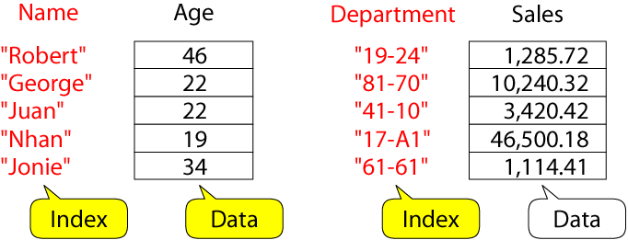
ILLUSTRATION: ASSOCIATIVE ARRAYS
awk arrays can use string as index

Slide 92
ASSOCIATIVE ARRAYS
Index must be unique: each index must be associated with an array value only once
Data values may be duplicated
The association of the index with its value is guaranteed
There is no ordering imposed on the indexes
An array index cannot be sorted. The data values in the array can be sorted

Slide 93
AWK BUILTIN SPLIT FUNCTION
split(string, array, fieldsep)
  divides string into pieces separated by fieldsep, and stores the pieces in array
  if the fieldsep is omitted, the value of FS is used.
Example:
split("auto-da-fe", a, "-")
sets the contents of the array a as follows:
a[1] = "auto"
a[2] = "da"
a[3] = "fe"

Slide 94
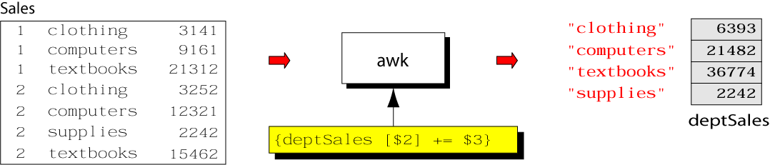
EXAMPLE: PROCESS SALES DATA
input file:
output:
  summary of category sales

Slide 95
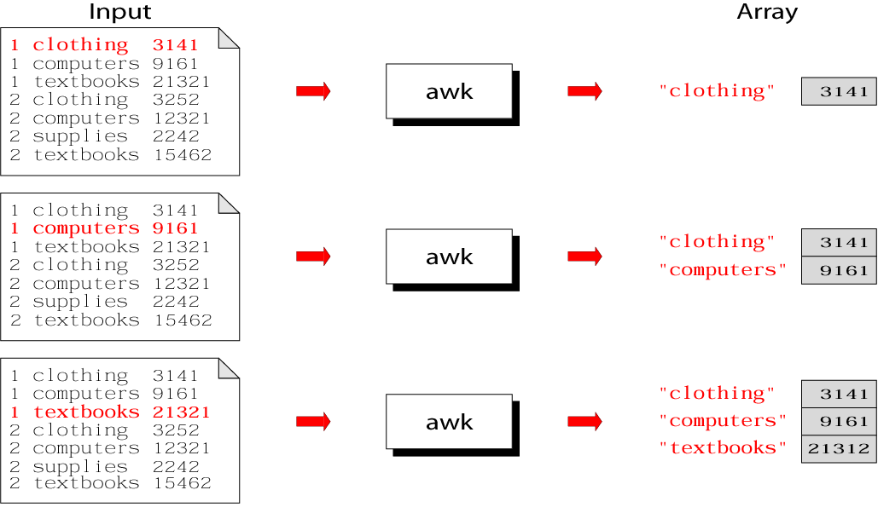
ILLUSTRATION: PROCESS EACH INPUT LINE

Slide 96
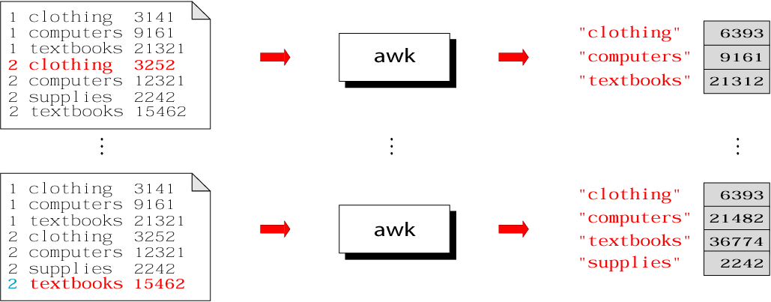
ILLUSTRATION: PROCESS EACH INPUT LINE
CSCI 330 - The UNIX System

Slide 97
SUMMARY: AWK PROGRAM
CSCI 330 - The UNIX System

Slide 98
EXAMPLE: COMPLETE PROGRAM
% cat sales.awk
{
deptSales[$2] += $3
}
END {
for (x in deptSales)
print x, deptSales[x]
}
% awk –f sales.awk sales
CSCI 330 - The UNIX System

Slide 99
DELETE ARRAY ENTRY
The delete function can be used to delete an element from an array.
Format:
  delete array_name [index]
Example:
  delete deptSales["supplies"]
CSCI 330 - The UNIX System

Slide 100
AWK STRING FUNCTIONS
length
length returns the number of characters in the string
Syntax:
length(string)
Example:
{
len=length($0)
print len
}

Slide 101
AWK STRING FUNCTIONS
index
returns the first position of a substring within a string
Syntax:
index(string,substring)
Example:
{
loc=index(MISSISSIPI, ”IS” )
print loc
}
output: 2

Slide 102
AWK STRING FUNCTIONS
substring
extracts a substring from a string
Syntax:
substr (string , position)
substr (string , position, length)
Example:
{
sub =substr (missisipi , 3)
sub =substr (missisipi , 3, 3)
}
output :

Slide 103
AWK STRING FUNCTIONS
split
split(string, array)
split(string, array, fieldseparator)
  divides string into pieces separated by fieldseparator, and stores the pieces in array
  if the fieldseparator is omitted, the value of FS is used.
Example:
split("auto-da-fe", a, "-")
sets the contents of the array a as follows:
a[1] = "auto"
a[2] = "da"
a[3] = "fe"

Slide 104
AWK STRING FUNCTIONS
substitution
substitute one string value for another
Syntax:
sub (reg _exp, replacementstring , inputstring)
Example:
success=sub (/bird/, ”animal”, $0)
sub returns 1 , if substitution was successful otherwise 0

Slide 105
AWK STRING FUNCTIONS
global substitution
substitute all occurrences of a value
Syntax:
gsub (reg _exp, replacementstring , inputstring)
Example:
gsub (/bird/, ”animal”, $0)

Slide 106
AWK STRING FUNCTIONS
match
returns the starting position of the matching expression
Syntax:
startpos=match (string, regexp)
Example:
startpos=match ($0, regexp)

Slide 107
tolower(string)
returns a copy of string, with each upper-case character converted to lower-case. Nonalphabetic characters are left unchanged.
Example: tolower("MiXeD cAsE 123")
returns "mixed case 123"
toupper(string)
returns a copy of string, with each lower-case character converted to upper-case.

Slide 108
MATHEMATICAL FUNCTIONS
cos(x)
exp(x)
log(x)
sin(x)
sqrt(x)

Slide 109
USING SYSTEM COMMANDS IN AWK
system commands can be used with awk using pipes, loops and system function
using pipes to get date
BEGIN {
“date” | getline
print ($1, $4)
}
output
sat 16:03:14

Slide 110
LOOPS
if there are multiple lines from the system commands , they must be read with loops
BEGIN {
while (“who ” | getline)
print ( $1, $2)
}
output

Slide 111
USING SYSTEM FUNCTION
awk utility consists of a system function that executes a command passed as an argument
returns 0 for success
BEGIN {
if ( system ( “ cp a.dat b.dat”) !=0)
{
print (”error”)
exit
}
print (“success”)
}

Slide 112
AWK & GREP
grep ‘ reg exp” file1
awk ‘$0 ~ /reg exp/ print ( $0)’ file1
grep -v ‘ reg exp” file1
awk ‘$0 !~ /reg exp/ print ( $0)’ file1

Slide 113
AWK BUILTIN FUNCTIONS
tolower(string)
returns a copy of string, with each upper-case character converted to lower-case. Nonalphabetic characters are left unchanged.
Example: tolower("MiXeD cAsE 123")
returns "mixed case 123"
toupper(string)
returns a copy of string, with each lower-case character converted to upper-case.

